Slide 1
PIG LATIN -- A Not-So-Foreign Language for Data Processing
Sri Harsha Dasari
Shiva Shankar Kommineni
Ramesh Kuthala
Raghavendra Rao Yentrapathi
Anil Kanth Nelluri
Sushma Alla
Meghana Chitta

Slide 2
Introduction
Data Analytics
It’s importance in today’s innovation
Existing Tools
SQL, Teradata, Oracle RAC
Need for new tools
Huge and unstructured/semi-structured data
Map Reduce
Birth of NoSQL tools

Slide 3
Comparison between SQL & PIG
Example
Suppose we have a table urls: (url, category, pagerank). The following is a simple SQL & pig queries that finds, for each sufficiently large category, the average pagerank of high-pagerank urls in that category
SQL
SELECT category, AVG(pagerank) FROM urls WHERE pagerank > 0.2 GROUP BY category HAVING COUNT(*) >10⁶
Pig
good_urls = FILTER urls BY pagerank > 0.2;
groups = GROUP good_urls BY category;
big_groups = FILTER groups BY COUNT(good_urls)>106;
output = FOREACH big_groups GENERATE category, category,
AVG(good_urls.pagerank);

Slide 4
Features & Motivation
Dataflow Language
Single high level data transformation
Optimization
Order of execution
User Defined Functions(UDF)
Example
spam_urls = FILTER urls BY isSpam(url);
culprit_urls = FILTER spam_urls BY pagerank > 0.8;

Slide 5
Features & Motivation
Quick Start and Interoperability
Runs queries directly
Doesn’t take control over data
Schema is optional
Example
good_urls = FILTER urls BY $2 > 0.2;
User Visualization

Slide 6
Nested Data Model
To capture the information about the positional occurrences of terms in given set of documents.
generally programmers think in terms of nested data structures hence they create a structure of the form
Map<documentId, Set<positions>> for each term
traditional databases: Flat tables, First Normal Form (1NF)
term_info: (termId, termString, ...)
position_info: (termId, documentId, position)

Slide 7
Why Nested Data Model ?
Handling nested data model is comparatively much easier than that of relational data model
Data is often stored on disk in nested fashion
Nested model allows programmers to use an algebraic language
It allows programmers to write user-defined functions

Slide 8
User-Defined Functions
To accommodates specialized data processing tasks
The input and output parameters follows fully nested data model
Pig Latin has only one type of UDF that can be used in all the constructs (filtering, grouping, per-tuple processing)
urls: (url, category, pagerank)
groups = GROUP urls BY category;
output = FOREACH groups GENERATE category, top10(urls);

Slide 9
Data Model
Pig has a rich and simple data model
Atom
Consists of simple atomic values( number, string)
Example:
‘bigdata’, ‘filesystem’, 10
Tuple
Sequence of fields each of which can be any of the data types
Example:
(‘bigdata’, ‘filesystem’, 10)

Slide 10
Data Model
Bag
Collection of tuples with possible duplicates
Example:
{ (‘hadoop’, ‘filesystem’),
(‘bigdata’, ‘principles’),
(‘bigdata’, ‘analytics’) }
Map
Collection of data items where each item has a key used for lookup
Example:
[ ‘hadoop’ → (‘filesystem’),
‘bigdata’ → {(‘principles’), (‘analytics’)} ]

Slide 11
Specifying Input Data: LOAD
Input is assumed to be a bag (sequence of tuples)
“USING” clause to specify a serializer
“AS” clause provide a schema
Bag handles are only logical
bag_handle = LOAD ‘file_name' [USING function()] [AS (schema)];
Ex: grades_table = LOAD ‘grades' AS (name: chararray, gpa: float);
Or
grades_table = LOAD ‘grades’ USING PigStoage() AS (name: chararray, gpa: float);
Notes:
Both the USING clause and the AS clause are optional.
If no schema is specified, fields must be referred to by position instead of by name (e.g., $0 for the first field).
The return value of a LOAD command is a handle to a bag.
The LOAD command does not imply database-style loading into tables.
No data is actually read, and no processing carried out, until the user explicitly asks for output.

Slide 12
Specifying Input Data: LOAD
Supports loading from compressed files
Built-in functions for load/store:
PigStorage: loads/stores relations using field-delimited text format
LOAD ‘student’ USING PigStorage('\t') AS (name: chararray, gpa: float)
TextLoader: loads relations from a plain-text format
LOAD ‘text_file’ USING TextLoader()
BinStorage: loads/stores relations from or to binary files.
LOAD ‘data.bin’ USING BinStorage()
Can use user-defined functions to load the data
LOAD ‘student’ USING myFunc(‘*')
Notes:
Both the USING clause and the AS clause are optional.
If no schema is specified, fields must be referred to by position instead of by name (e.g., $0 for the first field).
The return value of a LOAD command is a handle to a bag.
The LOAD command does not imply database-style loading into tables.
No data is actually read, and no processing carried out, until the user explicitly asks for output.

Slide 13
Per-tuple Processing: FOREACH
Apply some processing to each tuple in a bag
new_bag = FOREACH bag_name GENERATE field1, field2, …;
Each field can be:
A fieldname of the bag
A constant
A simple expression (ie: $1+$2)
A predefined function (ie: SUM, AVG, COUNT, FLATTEN)
A UDF (ie: sumMarks(hw1, hw2) )
Ex: student_names = FOREACH ‘grades_table’ GENERATE name

Slide 14
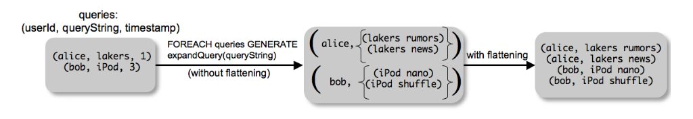
Per-tuple Processing: FOREACH
Can use FLATTEN to eliminate nesting in data.
expanded_queries = FOREACH queries GENERATE userId, FLATTEN(expandQuery(queryString));
Notes:
FLATTEN helps in independent processing of tuples by eliminating nesting.

Slide 15
Discarding Unwanted Data : FILTER
Select a subset of the tuples in a bag
newBag = FILTER bagName BY expression;
Expression uses simple comparison operators (==, !=, , …) and Logical connectors (AND, NOT, OR)
students_grade_B = FILTER grades_table BY gpa == 3.2 ;
Can use UDFs
students_grade_B = FILTER grades_table BY isGradeB(gpa);

Slide 16
Getting Related Data Together: COGROUP
It combines the similar tuples into one group from two or more relations based on the grouping columns.
First field of Tuple is group identifier.
i^{th} bag contains all tuples from the i^{th} input belonging to that group.
Grouping can also be done using UDFs.

Slide 17

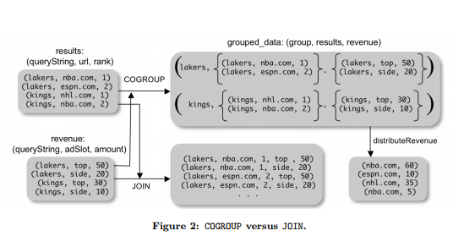

COGROUP vs JOIN

Slide 18

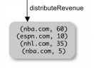
COGROUP vs JOIN : continued
JOIN is similar to COGROUP followed by taking a cross product of the tuples in the nested bags.
COGROUP can used in two forms as with flatten and without flatten.
url_revenues

Slide 19

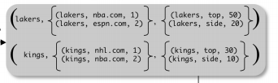
COGROUP vs JOIN : continued
In SQL
Example : Aggregation
Join by query string.
Group by query string and apply aggregation function.
Join

Slide 20



Special Case of COGROUP : GROUP
Used when one data set is involved the operation.
Example: Total revenue
JOIN in Pig Latin

Slide 21
Example: A
B
Key1 | Location1 | amount1
1 | 2 | 3
4 | 2 | 1
8 | 3 | 7
4 | 3 | 3
7 | 2 | 6
8 | 4 | 5
Key2 | Location2
2 | 4
8 | 8
1 | 2
2 | 5
2 | 8
4 | 6
4 | 8
> Cogroup_1 = COGROUP A by key1, B by key2;
> Dump cogroup_1;
(1,4,8,7,2)
Output:
( 1, { (1,2,3) , (1,2) } )
( 4, { (4,2,1) , (4,3,3) } , { (4,6) , (4,8) } )
( 8, { (8,3,7) , (8,4,5) } , { (8,8) } )
( 7, { (7,2,6) , { } )
(2, { }, { (2,4) , (2,5) , (2,8) } )
Grouping values

Slide 22
Map-Reduce in Pig Latin
As per data model, a map function operates on one input tuple at a time and outputs a bag of key-value pairs.
Reduce function then operates on all values for a key at a time to produce the final result.
map_result = FOREACH input GENERATE FLATTEN(map(*)); key_groups = GROUP map_result BY $0;
output = FOREACH key_groups GENERATE reduce(*);
First statement, applies the map UDF to every tuple on the input, and flattens the bag of key value pairs that it produces.
The third statement then passes the bag of values for every key to the reduce UDF to obtain the final result.

Slide 23
Other Commands
In Pig Latin most of the commands are similar to SQL
UNION: Returns the union of two or more bags.
CROSS: Returns the cross product of two or more bags.
ORDER: Orders a bag by the specified field.
DISTINCT: Eliminates duplicate tuples in a bag. This command is just a shortcut for grouping the bag by all fields, and then projecting out the groups.

Slide 24
Other Commands
For Example:
grouped_revenue = GROUP revenue BY queryString;
query_revenues = FOREACH grouped_revenue GENERATE queryString, SUM(revenue.amount) AS totalRevenue;
ordered_result = ORDER query_revenues BY totalRevenue;

Slide 25
Nested Operations
Commands that are discussed up to now are operated over one or more bags of tuples as input.
To perform Nested operations Pig Latin allow some commands to be nested in FOREACH.
At present, we only allow FILTER, ORDER, and DISTINCT to be nested within FOREACH.

Slide 26
Nested Operations
Example:
suppose we wanted to compute for each queryString, the total revenue due to the ‘top’ ad slot, and also the overall total revenue.
grouped_revenue = GROUP revenue BY queryString;
query_revenues = FOREACH grouped_revenue{ top_slot = FILTER revenue BY adSlot eq ‘top’; GENERATE queryString, SUM(top_slot.amount), SUM(revenue.amount); };

Slide 27
Asking for Output
Users can store the result of the command to a file by using STORE command.
STORE query_revenues INTO ‘myoutput’ USING myStore();
Above statement specifies output to be stored into myoutput file using the custom serializer mystore.

Slide 28
Implementation
Pig is designed to allow different systems as the execution platform for pig Latin.
Pig system does two tasks to compile a pig Latin program:
Building a logical plan.
Compiling the logical plan to physical plan and execute

Slide 29
Building logical plan:
Pig interpreter first parses the commands issued by the clients.
Verifies whether all the input files and bags referred in the command are valid
Creates a logical plan for each bag defined.
No processing is carried out when the logical plans are constructed.

Slide 30

Building a Logical Plan Example
A = LOAD ‘user.dat’ AS (name, age, city);
B = GROUP A BY city;
C = FOREACH B GENERATE group AS city, COUNT(A);
D = FILTER C BY city IS ‘kitchener’ OR city IS ‘waterloo’;
STORE D INTO ‘local_user_count.dat’;

Slide 31
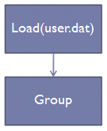
Building a Logical Plan Example
A = LOAD ‘user.dat’ AS (name, age, city);
B = GROUP A BY city;
C = FOREACH B GENERATE group AS city, COUNT(A);
D = FILTER C BY city IS ‘kitchener’ OR city IS ‘waterloo’;
STORE D INTO ‘local_user_count.dat’;

Slide 32
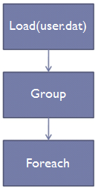
Building a Logical Plan Example
A = LOAD ‘user.dat’ AS (name, age, city);
B = GROUP A BY city;
C = FOREACH B GENERATE group AS city, COUNT(A);
D = FILTER C BY city IS ‘kitchener’ OR city IS ‘waterloo’;
STORE D INTO ‘local_user_count.dat’;

Slide 33
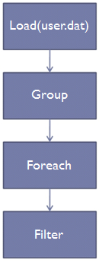
Building a Logical Plan Example
A = LOAD ‘user.dat’ AS (name, age, city);
B = GROUP A BY city;
C = FOREACH B GENERATE group AS city, COUNT(A);
D = FILTER C BY city IS ‘kitchener’
OR city IS ‘waterloo’;
STORE D INTO ‘local_user_count.dat’;

Slide 34
Building a Logical Plan Example
A = LOAD ‘user.dat’ AS (name, age, city);
B = GROUP A BY city;
C = FOREACH B GENERATE group AS city, COUNT(A);
D = FILTER C BY city IS ‘kitchener’
OR city IS ‘waterloo’;
STORE D INTO ‘local_user_count.dat’;
Processing is triggered when user invokes store command

Slide 35
Map reduce plan compilation:
Step1: Map function just assigns keys to tuples and the reduce function is initially no-op.
Step 2: The sequence of commands from load to the first COGROUP operation C1 are pushed into the map function C1.
Step 3: The commands that are between subsequent COGROUP commands Ci and Ci+1 are pushed into either reduce function of Ci or map function of Ci+1.

Slide 36
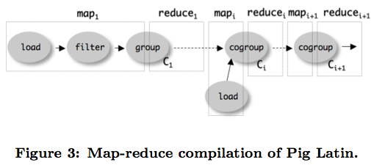

Slide 37
Efficiency:
Parallelism
Loading data - Files are loaded from HDFS
Statements are compiled into map-reduce jobs
Inefficiency:
The inflexibility of map-reduce primitive results in some overhead in compiling Pig Latin into map-reduce jobs.

Slide 38
Efficiency with nested bags:
COGROUP command places tuples belonging to same group in one or more nested bags.
In many cases, the nested bags created in each tuple of a COGROUP statement never need to physically materialize.
One common case is where the user applies algebraic aggregation function over the result of the COGROUP operation.
An algebraic function is structured as a tree of sub-functions with each leaf operating over subset of data.

Slide 39
Efficiency:
Pig provides an interface for writing algebraic UDFs so they can take advantage of this optimization as well.
Inefficiency:
Non-algebraic aggregate functions need entire bag to materialize. This may cause a very large bag to spill to disk if it doesn’t fit in memory.

Slide 40
How to verify the semantics of an analysis Program?
To Run the program against whole data,It takes Hours!!
Generate a sample data.
Problems with sample data:
Operations like joins and filter may generate empty results.
Pig comes with a debugging environment called Pig-Pen which generates the sample on its own based on the commands written.

Slide 41
Pig-Pen
Samples data from large dataset.
Application of single pig-commands on the dataset.
In case of empty results, Pig resamples.
Removes Redundant samples.

Slide 42
Suppose we have two data sets a log of page visits (User,Url,Time) and catalog of pages and pageranks (Url,Pagerank).
The program joins the two data sets after first running the log entries through a UDF that converts urls to a canonical form.
After the join, the program groups tuples by user, computes the average pagerank for each user, and then filters users by average pagerank.

Slide 43
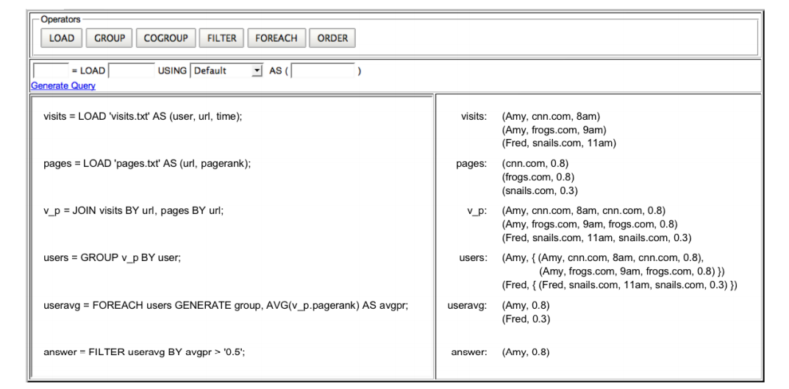
Pig-pen Screenshot

Slide 46
Design & Features:
Pig-Pen is deigned to match clojure as close as possible.
Queries are manipulated as expression trees.
Each operation is represented as a map of information about what behavior is desired.
These maps can be nested together to build a tree representation of a complex query.
Each command also contains references to its ancestor commands.
When executed, that query tree is converted into a directed acyclic query graph.
This allows for easy merging of duplicate commands, optimizing sequences of related commands, and instrumenting the query with debug information.

Slide 47
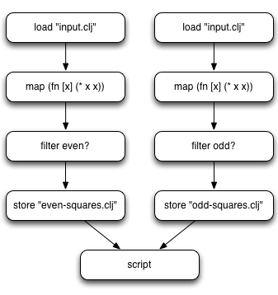
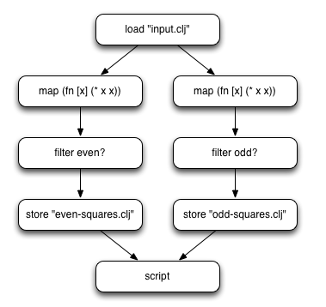
Optimization: De-duping
Source:https://github.com/Netflix/PigPen

Slide 48
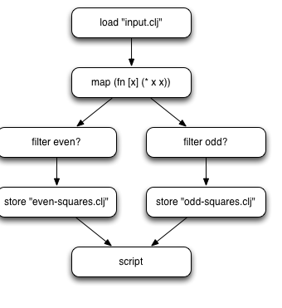
Now that we have a optimized query every operation is unique.
Can generate queries within loops without worrying about duplication
Pig-pen executes only the unique parts.
Source:https://github.com/Netflix/PigPen

Slide 49
Testing,Local Execution,Debugging
Pig pen returns data in the REPL.(read-evaluate-print-loop).
Provides Unit testing for the Queries.
Debug mode when enabled will write to the disk the result of every operation along with the outputs.
It is coupled with Grapth-Viz visualisation.

Slide 50
Any queries?

Slide 51
References
https://en.wikipedia.org/wiki/Pig_%28programming_tool%29
https://github.com/Netflix/PigPen

Slide 52
Thank You

